Slide 1
Resumes &
Cover Letters
Professional Prep Lesson #1

Slide 2
Overview
To be an effective tool in your search for a job or internship, your resume and cover letter should be marketing documents. They should be focused on delivering a specific and relevant message about you to your target audience. It should help the reader understand who you are, the qualifications you offer, and the type of opportunities you are seeking. Your resume and cover letter, as marketing tools, should catch the employer’s interest and, if successful, result in an interview.

Slide 3
Goals of Lesson
Understand the differences of resume formats
Identify what to include, and not to include, on a resume
Learn how to write an effective cover letter

Slide 4
Resumes, CVs, and Cover Letters
A resume is a brief, informative document summarizing your abilities, education, and experience. It should highlight your strongest assets and differentiate you from other candidates.
Used most frequently in academic settings, a CV (curriculum vitae) is also a summary of your experience and abilities, but a CV will include more credentials relevant to academia and research, such as publications, presentations and references.
Your cover letter is a way to introduce yourself to organizations in a narrative form that will accompany your resume. Use your cover letter to describe your qualifications as well as your interest in both the job and organization so the employer will want to interview you. Since the primary purpose of a resume and vour letter is to “market” you, always keep the organization’s hiring needs in mind.

Slide 5
Formatting of Resumes
There are 3 types of formatting decisions you can make for your resume.
Reverse- Chronological: This is the most traditional format with your most recent employment listed first. It typically includes sections such as:
  Contact information
  Work experience
  Additional skills
  Education
  Accomplishments

Slide 6
Reverse- Chronological should be used if:
You want to show a vertical career progression
You want to apply to a job in a similar field
You want to promote upward career mobility
You should not use Reverse-Chronological if:
You have major gaps in employment history
You are changing your career path
You change jobs every few months

Slide 7
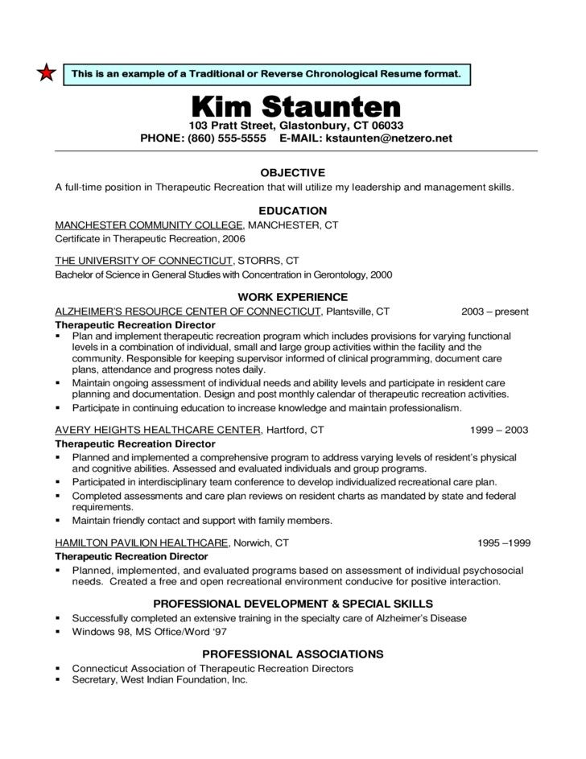

Slide 8
Functional resume- while chronological places emphasis on career progression, a functional resume is for a skills-based resume. It heavily emphasizes the applicant’s qualifications, so it is more suitable for those with an expert level of experience. It has similar sections to chronological with a few differences:
  Contact information
  Work experience
  Relevant skills section
  Education
  Accomplishments
Functional resume should be used if:
You have gaps in employment history
You are changing your career industry
You want to highlight a specific skill set
You should not use Functional formatting if:
You want to highlight upward career mobility
You are an entry level candidate that lacks experience
You lack transferable skills

Slide 9
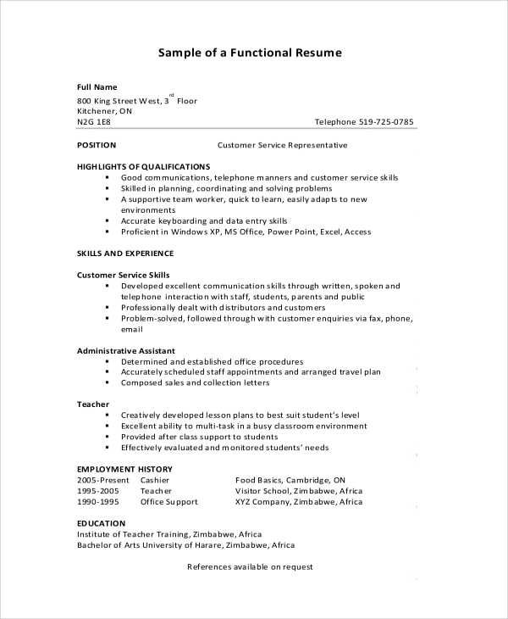

Slide 10
Combination resume format merges bits and pieces from both chronological and functional formats. It focuses on specific qualifications, but the professional experience is similar to chronological formatting. This is generally reserved for those with a great deal of experience in a particular industry.
Use Combination if:
You want to highlight a developed skill set within a specific carrer
You want to change your career path
You are a master of the subject you are applying to
Do not use Combination formatting if:
You want to highlight your education
You lack experience
You are an entry level candidate

Slide 11
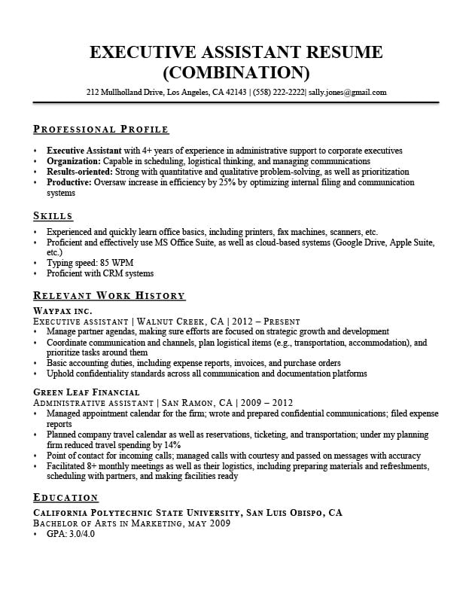

Slide 12
Formatting Continued
Regardless of the type of resume formatting you choose, you should do the following:
Font type- Easy to read font that doesn’t stick out too much
Font size- 11-12 pt for normal font, 14-16 pt for section titles
Bullets instead of paragraphs
No spelling or grammatical errors
White space and margins
Save it as a .pdf if you are submitting electronically
Page length- keep it to one page unless it will add significant value

Slide 13
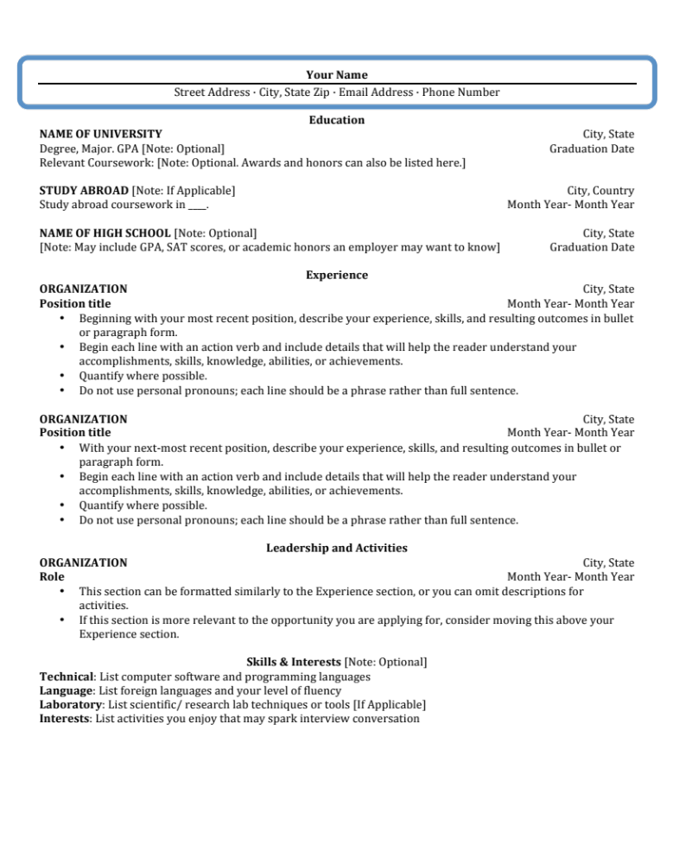
Contact Information
Name
Email Address
Phone Number
Address (Optional)
LinkedIn URL (Optional)

Slide 14
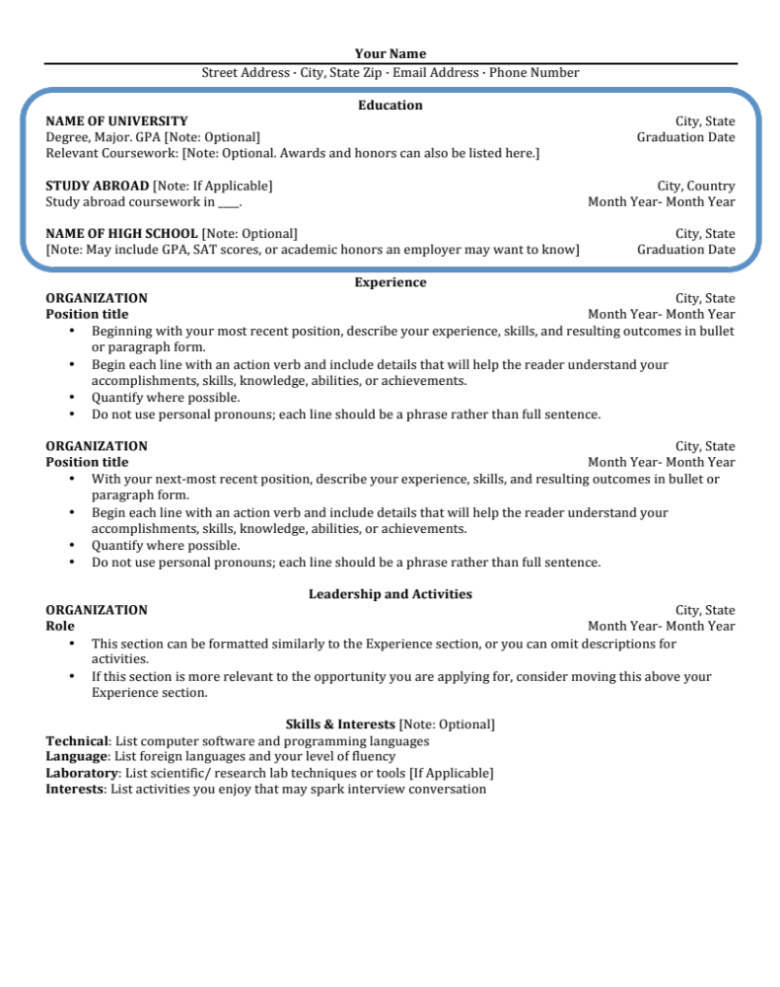
Education
Name of School
Concentration
Graduation Date/Location
Relevant Courses (Optional)
GPA/SAT Scores (If Asked)

Slide 15
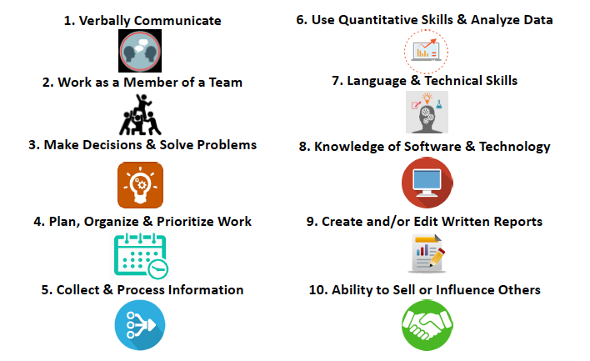
Top 10 Skills Employers Seek

Slide 16
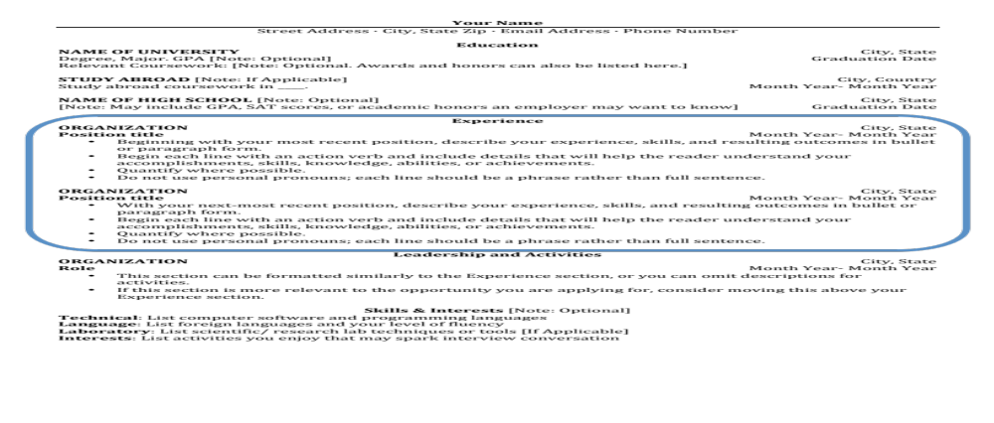
Experience
Use a different action verb to begin each bullet point
Use reverse chronological order (most recent first) within each section
Within each experience begin with most relevant/strongest bullet point

Slide 17
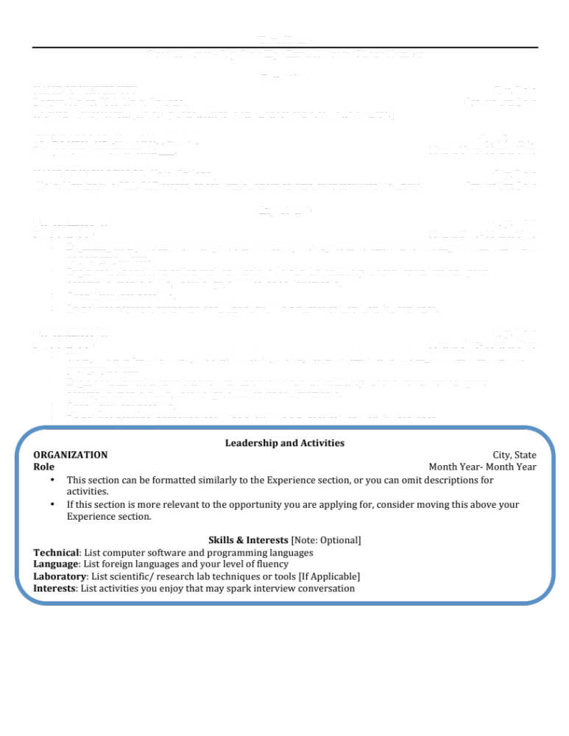
Additional Sections (Optional)

Slide 18
Things to NOT put in Resume
Personal information such as photo, age, or marital status
Pronouns- I, Me, My
Abbreviations (except for state)
“References Available Upon Request”

Slide 19
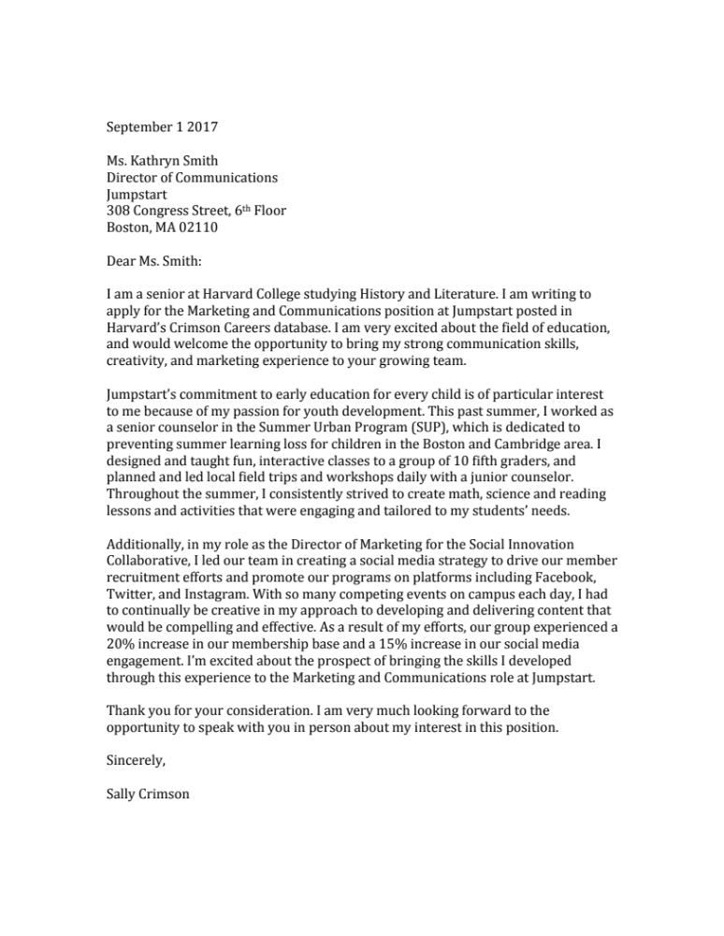
Cover Letters
One page marketing tool
Writing sample
Why you? Why them?
Highlight relevant skills
Tailored to organization
Create excitement and interest

Slide 20
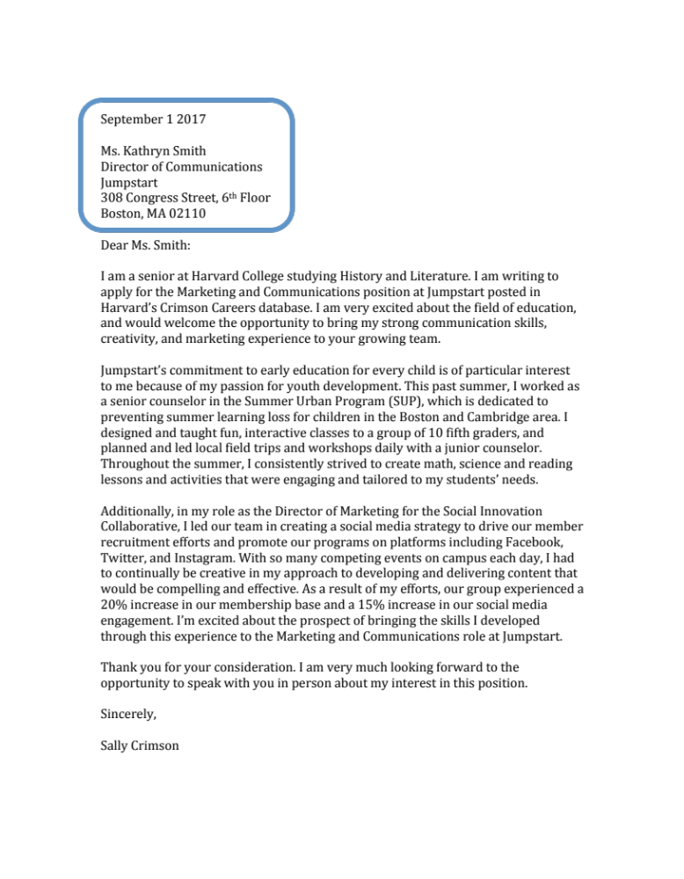
Contact Information
Use date of application
Address to a particular person
Use career center or LinkedIn to find contact
DO NOT write “To whom it may concern”

Slide 21
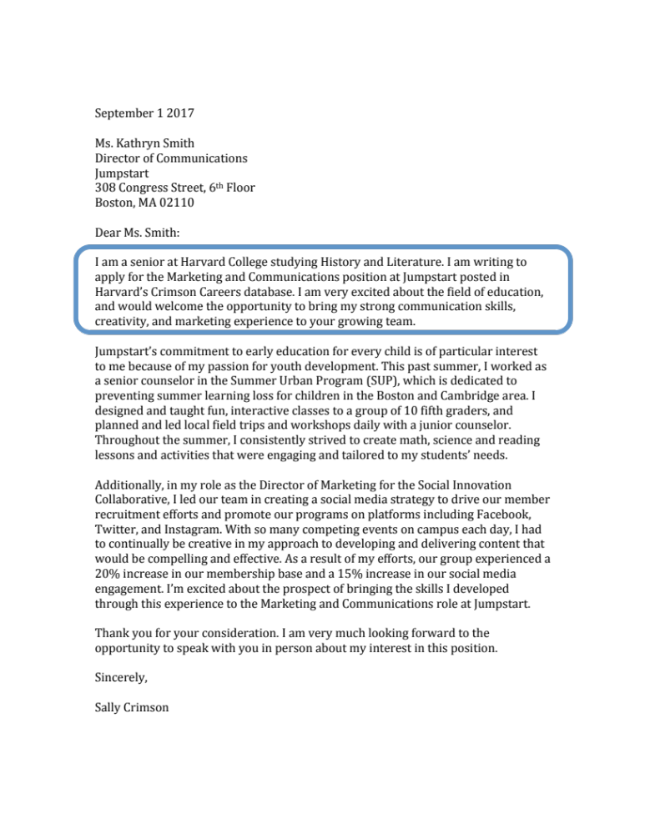
Opening Paragraph
Introduce self
Position applying for and how you heard about it
Why them?
OK to include the name of individuals you have met and talked to at the company

Slide 22
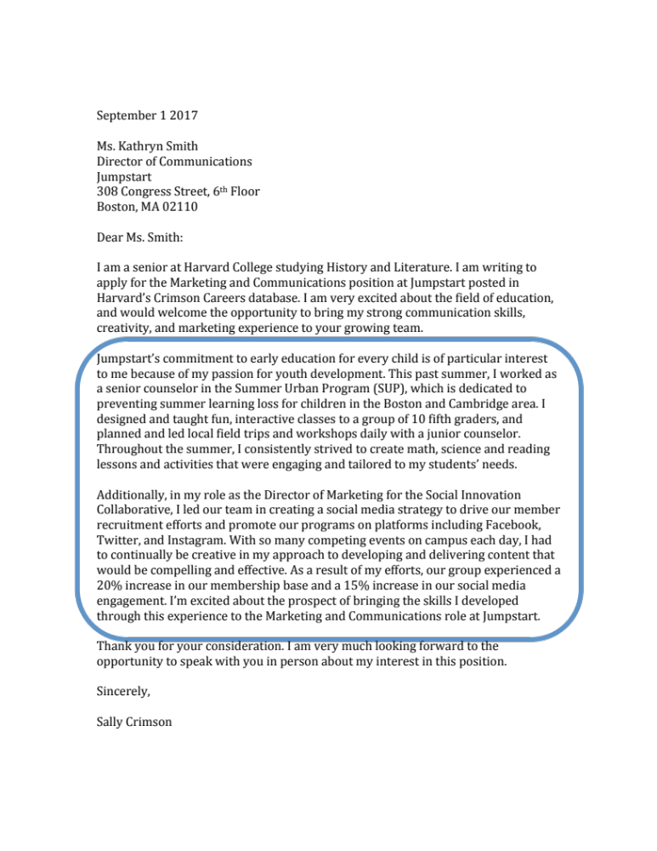
Middle Paragraph(s)
“Sales Pitch”- why you?
Tailor to the job description- what do they need?
1-2 examples- not the same content from resume
Highlight relevant qualifications

Slide 23
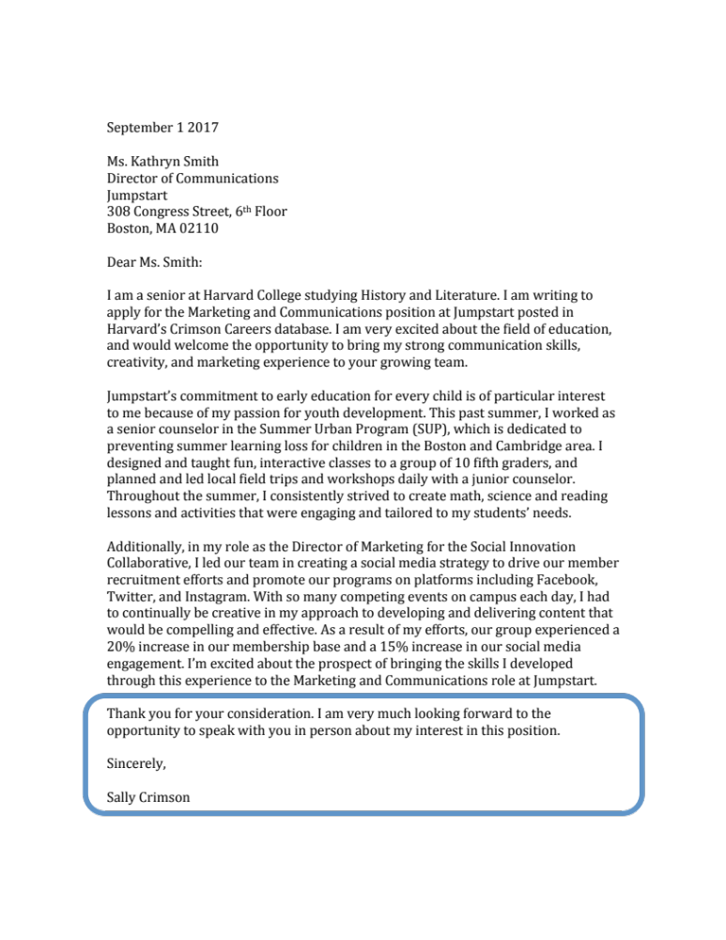
Closing Paragraph
Reiterate interest and enthusiasm
Thank reader for considering your application
Indicate next steps
Include your name as a signature

Slide 24
Resumes &
Cover Letters
Review Q & A

Slide 25
A curriculum vitae is similar to a resume, but with more focus on academia publications and research.

Slide 26
When applying to an engineering internship, you should list “babysitting” under relevant skills.

Slide 27
A reverse-chronological formatted resume is best for those with large gaps in their employment history.

Slide 28
It is okay to use pronoun such as I, Me or My, in a resume.

Slide 29
It is important to keep the organization’s hiring needs in mind when you are writing your cover letter.

Slide 30
You Have Completed
Resumes & Cover Letters:
Professional Prep Lesson #1

