Slide 1
Nutrition Applications
Nutrition Lesson #2

Slide 2
Overview
Nutrition is essential to performance during all types of exercise. The foods consumed in a diet are used to provide the body with enough energy to fuel an activity regardless of the intensity of activity. Athletes have different nutritional needs to support the vigorous level they compete and practice at.

Slide 3
Goals of Lesson
Interpret the Nutrition Facts labels on food items
Understand the purpose and function of nutrition recommendations

Slide 4
Units of Measure
In nutrition, there are two systems of commonly used measurements: Metric and US Customary.
We need both because the US won’t adopt the metric system completely.
Commonly used prefixes for the Metric system:
Micro- (μ) | 1/1,000,000th (one millionth)
Milli– (m) | 1/1000th (one thousandth)
Centi-(c) | 1/100th (one hundredth)
Deci- (d) | 1/10th (one tenth)
Kilo- (k) | 1000x (one thousand times)

Slide 5
Mass
Metric System | US Customary System | Conversions
Microgram (μg) | Ounce (oz) | 1 oz = 28.35 g
Milligram (mg) | Pound (lb) | 1 lb = 16 oz
Gram (g) |  | 1 lb = 454 g
Kilogram (kg) |  | 1 kg = 2.2 lbs
Volume
Metric System | US Customary System | Conversions
Milliliter (mL) | Teaspoon (tsp) | 1 tsp = 5 mL
Deciliter (dL) | Tablespoon (tbsp) | 1 tbsp = 3 tsp = 15 mL
Liter (L) | Fluoid ounce (fl oz) | 1 fl oz = 2 tbsp = 30 mL
 | Cup (c) | 1 c = 8 fl oz = 237 mL
 | Pint (pt) | 1 pt = 2 c = 16 fl oz
 | Quart (qt) | 1 qt = 4 c = 32 fl oz = 0.95 L
 | Gallon (gal) | 1 gal = 4 qt

Slide 6
Understanding Daily Reference Intakes
Dietary Reference Intakes (DRI) are the recommendation for specific nutrients and consist of a number of different types of recommendations. This DRI system is used in both the US and Canada.
DRI is an umbrella term for four reference values:
Estimated Average Requirements (EAR)
Recommended Dietary Allowances (RDA)
Adequate Intakes (AI)
Tolerable Upper Intake Levels (UL)
DRIs are not minimum or maximum nutritional requirements and are not intended to fit everybody. They are to be used as guides only for the majority of the healthy population.

Slide 7
Estimated Average Requirements
EAR for a nutrient is determined by a committee of nutrition experts who review scientific literature to determine a value that meets the requirements of 50% of people in their target group.
For each nutrient, a specific bodily function is chosen as the criterion on which to base the EAR.
Ex: the EAR for calcium is set using a criterion to maximize bone health.
The EAR value becomes the scientific foundation upon which RDA values are set.

Slide 8
Recommended Daily Allowances
Once the EAR of a nutrient has been established, the RDA can be mathematically determined. While the EAR is set at a point to meet the needs of half the population, the RDA value is set to meet the needs of the vast majority (97-98%) of the target healthy population.
RDA is a recommendation for the general majority of the population- NOT the same thing as individual nutritional requirements. It is very likely however that if an individual is following the RDA, they are most likely meeting their actual requirement for that nutrient

Slide 9
Requirement vs. Recommendation
There is a distinct difference between a requirement and a recommendation.
For instance, the DRI for Vitamin D is a recommended 600 international units each day. However, in order to find out your true personal requirements for Vitamin D, a blood test is necessary. The blood test will provide an accurate reading from which a medical professional can gauge your required daily Vitamin D amounts. This may be considerably more or less than the DRI, depending on what your level actually is.

Slide 10
Adequate Intake
AIs are created for nutrients when there is insufficient consistent scientific evidence to set an EAR for the entire population. As with RDAs, AIs can be used as nutrient-intake goals for a given nutrient.
Example: There has not been enough sufficient scientific research for the nutritional requirements for infants. Consequently, all of the DRI values for infants are AIs derived from nutrient values in human breast milk. For older babies and children, AI values are derived from human milk coupled with data on adults. The AI is meant for a healthy target group and is not meant to be sufficient for certain at-risk groups, such as premature infants.

Slide 11
Tolerable Upper Intake Levels
The UL was established to help distinguish healthful and harmful nutrient intakes.
Developed in part as a response to the growing usage of dietary supplements, ULs indicate the highest level of continuous intake of a particular nutrient that may be taken without causing health problems.
When a nutrient does not have any known issue if taken in excessive doses, it is not assigned a UL. However, even when a nutrient does not have a UL it is not necessarily safe to consume in large quantities.

Slide 12
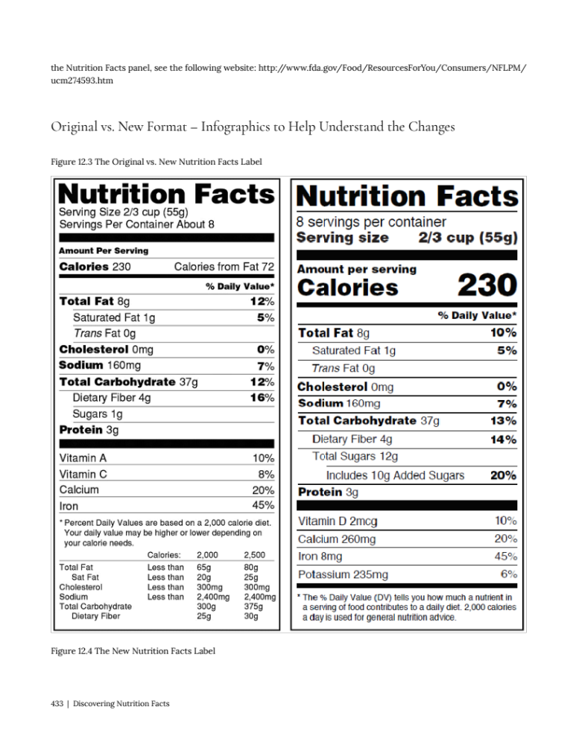
Reading a Nutrition Label
The first part of the Nutrition Facts panel gives information on the serving size and how many servings are in the container.
All other values listed thereafter, from calories to the dietary fiber, are based on the one serving.

Slide 13
The “Percent Daily Value” helps you determine if the food is a good source of a particular nutrient or not.
The Daily Value (DV) represents the recommended amount of a given nutrient based on the RDI of that nutrient in a 2,000-kilocalorie diet. The percentage of Daily Value (% DV) represents the proportion of the total daily recommended amount you will get from one serving of food.
%DV <5 is considered low
%DV >20 is considered high

Slide 14
Daily Values for Non-Athletes
These DV are based on a 2,000 caloric intake daily, for inactive individuals.
Food Component | DV
Total Fat | 65 grams (g)
Saturated Fat | 20 g
Cholesterol | 400 milligrams (mg)
Sodium | 2,400 mg
Potassium | 3,500 mg
Total Carbohydrate | 300 g
Dietary Fiber | 25 g
Protein | 50 g

Slide 15
Food Component | DV
Vitamin A | 5,000 International Units (IU)
Vitamin C | 60 mg
Calcium | 1,000 mg
Iron | 18 mg
Vitamin D | 400 IU
Vitamin E | 30 IU
Vitamin K | 80 micrograms (μg)
Thiamin | 1.5 mg
Riboflavin | 1.7 mg
Niacin | 20 mg
Vitamin B6 | 2 mg
Folate | 400 μg
Vitamin B12 | 6 μg

Slide 16
Food Component | DV
Biotin | 300 μg
Pantothenic acid | 10 mg
Phosphorus | 1,000 mg
Iodine | 150 μg
Magnesium | 400 mg
Zinc | 15 mg
Selenium | 70 μg
Copper | 2 mg
Manganese | 2 mg
Chromium | 120 μg
Molybdenum | 75 μg
Chloride | 3,400 mg

Slide 17
Nutritional Needs of Athletes
The typical inactive individual needs about 2,000 calories per day.
Competitive athletes may need 3,000 to over 5,000 calories daily depending on their energy needs.
Energy intake is the foundation of an athlete’s diet because it supports optimal body functions, determines the amount of intake of macronutrients and micronutrients, and assists in the maintaining of body composition.
Factors that affect energy needs of athletes:
Endurance athlete vs. strength athlete
Gender
Age
Weight
Body composition

Slide 18
Daily Needs for Carbohydrates
Activity Level | Example of Exercise | Increase Carbohydrate*
Light | Low intensity or skill based activity | 3-5
Moderate | Moderate exercise program (about 1 hour per day) | 5-7
High | Endurance program (about 1-3 hours/day of moderate to high intensity exercise | 6-10
Very High | Extreme commitment (about 4-5 hours/day of moderate to high intensity exercise | 8-12
* Carbohydrate is in gram/kg of athlete’s body weight/day

Slide 19
Daily Needs for Lipids
Fat is a necessary component of a healthy diet to provide energy, essential fatty acids and to facilitate the absorption of fat-soluble vitamins.
Athletes are recommended to consume the same amount of fat in the diet as the general population- 20-35% of their energy intake.
Athletes who choose to excessively restrict their fat intake in an effort to lose body weight or improve body composition should ensure they are still getting the minimum recommended amount of fat.
Fat intakes below 20% of energy intake will reduce the intake of fat-soluble vitamins and essential fatty acids, especially omega 3’s.

Slide 20
Daily Needs for Proteins
It is recommended that athletes consume 1.2 to 2.0 g/kg/day of protein in order to support metabolic reactions and to help muscles with maintenance, growth and repair.
High intakes may also be needed for short periods of intense training or when reducing energy intake.
Group | Protein Intake (g/kg body weight)
Most adults | 0.8
Endurance athletes | 1.2-1.4
Vegetarian endurance athletes | 1.3-1.5
Strength athletes | 1.6-1.7
Vegetarian strength athletes | 1.7-1.8

Slide 21
Nutrition Applications
Review Q & A

Slide 22
Strength athletes should consume 1.2 to 1.4 g/kg/day of protein.

Slide 23
The nutrition facts label’s Daily Value is based on a 2,000 kilocalorie diet.

Slide 24
___ is the value set to meet the needs of the vast majority (97-98%) of the target healthy population.
A. Estimated Average Requirements
B. Recommended Daily Allowances
C. Adequate Intake
D. Tolerable Upper Intake Levels
B.

Slide 25
Daily Reference Intakes are not minimum or maximum nutritional requirements.

Slide 26
Athletes need to consume more fats than non-athletes.

Slide 27
You Have Completed
Nutrition Applications:
Nutrition Lesson #2

Slide 28
References
Titchenal, A., Calabrese, A., Gibby, C., Fialkowski Revilla, M. and Meinke, W., 2018. Human Nutrition. [ebook] PrinceXML, pp.3-23; 423-457; 543-567. Available at: <http://pressbooks.oer.hawaii.edu/humannutrition/>.

